Slide 1
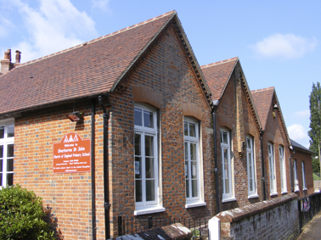
KS2 SATS 2025
Y6 Information Session

Slide 2
Welcome and thank you for coming
Agenda
The end of year assessment process
An opportunity to look briefly at examples of the tests taken by the pupils
Ideas of how you can support your child at home
An opportunity to ask any questions that you might have

Slide 3
Key Stage 2 SATs – what are they?
KS2 SATs are tests taken at the end of year 6. They test children on what they have learnt between year 3 and year 6.
They are mandatory tests from the National Curriculum assessment programme. All state schools in England are required to provide the tests.
They are sent off, marked externally and then the results are sent out to schools.
Standard
Assessment
Tests

Slide 4


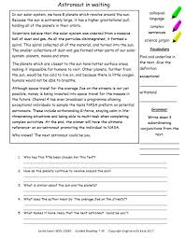
What are the children tested on?
Maths
English Grammar, Punctuation and Spelling
(EGPS)
Reading
Writing (Teacher Assessed)
Science (Teacher Assessed)

Slide 5
SATs week timetable
English grammar, punctuation and spelling paper 1: questions (45 mins)
English grammar, punctuation and spelling paper 2: spelling (20 mins)
English reading paper (60 mins)
Mathematics paper 1: arithmetic (30 mins)
Mathematics paper 2: reasoning (40 mins)
Mathematics paper 3: reasoning (40 mins)
This year’s tests are timetabled for the week beginning Monday 12th May.
Monday 12th May
Tuesday 13th May
Wednesday 14th May
Thursday 15th May

Slide 6

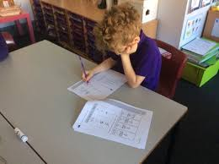
Test arrangements
The children will be completing the tests in the hall. This should be very familiar to them and will allow the children space and a table to themselves to spread out.
A few children may have slightly different arrangements – these will be arranged nearer the time.

Slide 7
The English Tests
Grammar, Punctuation and Spelling
  Paper 1: questions (45mins)
  Paper 2: spellings (approx. 20mins)
Reading
  Reading paper (1 hour)
Writing
  A teacher assessment of writing will be made in May/June 2025. Children will receive a level of WTS, EXS or GDS.

Slide 8

Grammar, punctuation and spelling test - Monday
If you score above 50% in your SPaG test then you’ll probably get the expected standard.
Top tip! One thing you can do to improve your English scores all round is to read. Reading for pleasure is the single most impactful thing you can do to improve your outcomes.

Slide 9
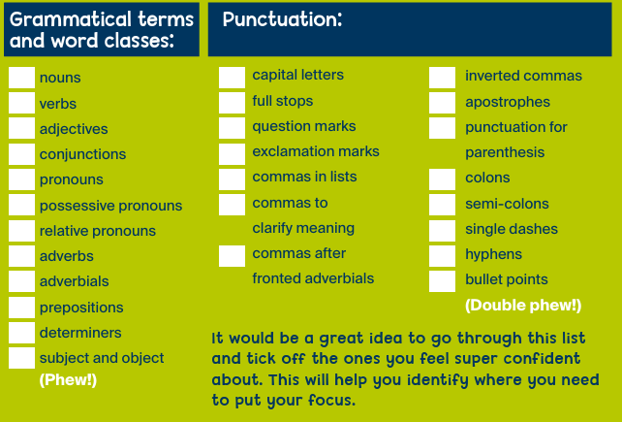
There are two main areas that come up time and time again! They are:

Slide 10
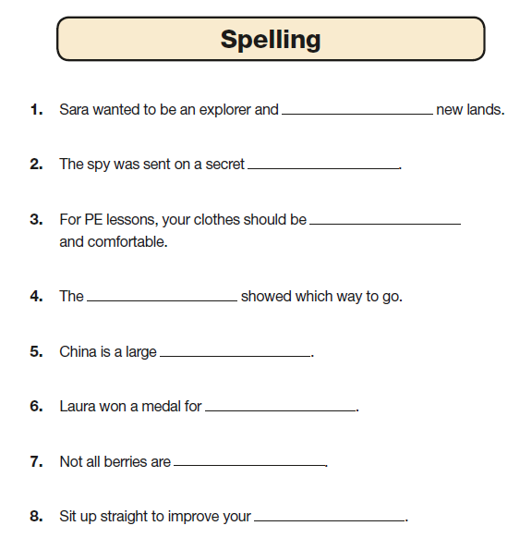
Spelling
There are 20 spelling sentences.
The spelling words are tested within the context of a sentence.
As the sentences are read out to the children, they fill in the correct spellings.

Slide 11
Reading Test – Tuesday
The reading test has three different extracts (pieces of writing) with questions on each one. Two of the extracts are usually fiction and one is usually non-fiction.
There will be questions on each extract. The questions are designed to check different skills:
Vocab - do you know what certain words mean?
Infer - can you ‘read between the lines’ and work out what the implied meaning is?
Predict - can you make supported suggestions about what might happen next?
Explain - can you explain why a writer might choose certain words or phrases?
Retrieval - can you search to find answers in the text?
Summarise - can you pull lots of small ideas together to explain the overall meaning?

Slide 12

These skills are very tricky to revise eg: you either know the meaning of the word ‘patestrched’ or you don’t. So in order to do well on the reading you need to do two things:
You need to read as much and as widely as you can. Try reading something you never would normally pick up.
2. Become a super-sleuth. Use the information in the rest of the sentence, or the rest of the paragraph to make an educated guess.

Slide 13
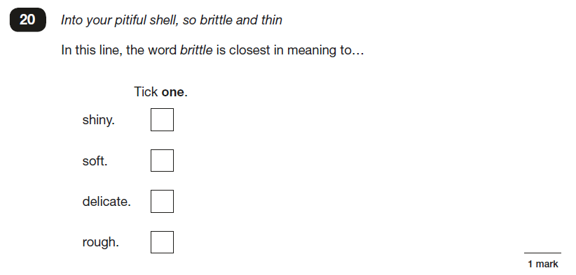
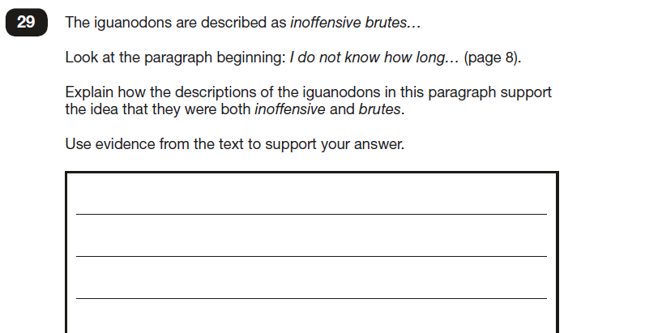

Slide 14
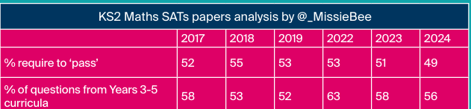
The maths tests – Wednesday and Thursday
There will be three maths papers:
1 arithmetic paper
2 reasoning papers
If you look at the table above, you can see that in previous years you could achieve expected standard in your maths SATs if you managed to get around 50% of your answers correct.
And, you can see that more than half of the maths paper was on things you will have learned in years 3 to 5. As this is the case most years, it’s unlikely to change very much for your SATs. This means that we need to make sure you remember the maths you learned last year and the two years before that. (Don’t worry - we’ll help!)

Slide 15
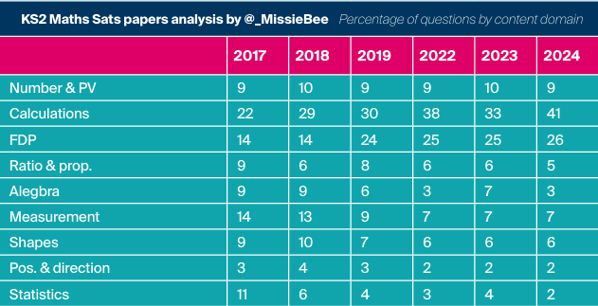
This table shows the topics that they will be tested on, and what percentage of the paper had those types of questions.
You can see that two of the biggest topics every year are:
1. Calculations (A fancy word for using addition, subtraction, multiplication and division to solve maths problems!)
2. Fractions, decimals and percentages.

Slide 16
Calculations and FDP
So it makes sense to practise these two topics as much as you can, and make sure that what you’ve already been taught about them is really solid in your mind.

Slide 17
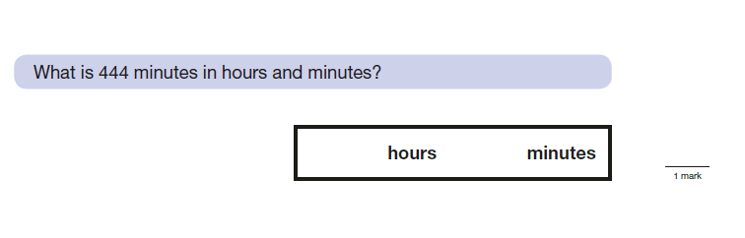
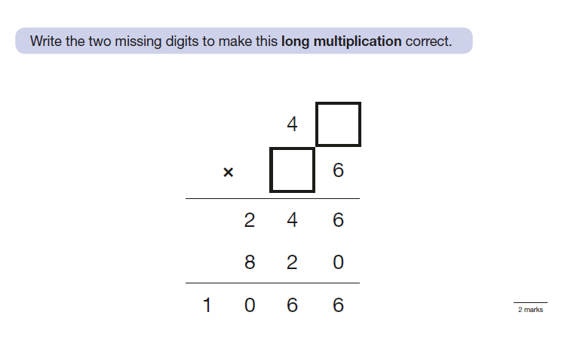

Slide 18
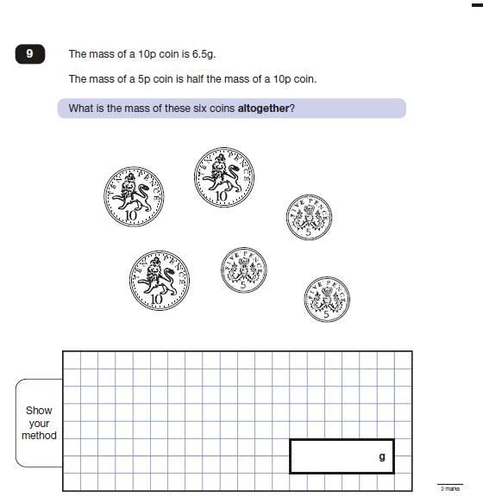

Slide 19
Reporting the results
All test outcomes will be reported as scaled scores and you will be told whether or not your child has met the expected standard.
The national (expected) standard is a scaled score of 100.
The children’s raw scores will be turned into scaled scores using a conversion table devised by the DFE.
You will be given your child’s scaled scored and whether they have reached the expected standard.
NS means that the expected standard was not achieved
AS means that the expected standard was achieved
No child will be awarded greater depth for maths, reading or GPS.

Slide 20
How are we helping the children to be prepared?
Continuous assessment – identifying the gaps and helping to fill them
Daily maths reviews of arithmetic style questions
Focused grammar and spelling lessons
Focused reading sessions
Looking at practice papers and teaching ‘test techniques’
Practising previous SATs papers
Booster groups
Keep-up maths

Slide 21
How can you help at home?
Support/encourage your child to complete their homework
Discuss their learning with them and support them with areas that they have found challenging
Listen to your child read regularly and discuss a variety of texts (do they understand what they are reading?) Don’t just listen to them read!
Try short bursts of arithmetic practice and recalling times tables facts
Use websites and online activities to practise skills
Encourage your child to think positively and believe in themselves
Do not put your child under too much pressure
Help them to relax and do things that are not related to school/SATs

Slide 22
Throughout the weeks leading up to SATs, we recommend:
Early night and lots of sleep
Good attendance is very important
A good breakfast every day – children find it hard to concentrate on a hungry stomach
A positive attitude – encourage your child to embrace the mistakes they make and learn from them rather than dwelling on them
Lots of praise, encouragement and reassurance

Slide 23
Week of SATs
No school work when they get home
Lots of relaxing activities that they enjoy
Early nights
A good hearty breakfast daily
Good punctuality
Reminders that they are so much more than a test score!

Slide 24
Resources to help at home
CGP guides – these will be given to the children by us for homework. Please do not buy these!
http://www.bbc.co.uk/schools/revision/ BBC BiteSize - This is an excellent site, providing revision help for KS2, KS3, KS 4 and KS5. This covers all subjects through activities and tests.
http://www.icteachers.co.uk/children/children_sats.htm ICT Teachers - A wide range of KS2 SATs questions, from both past papers and their own team of teachers.
My Maths
https://myminimaths.co.uk/year-6-arithmetic-practice-papers/ My Mini Maths arithmetic practice questions, as well as questions on all other concepts
http://www.compare4kids.co.uk/literacy.php Literacy Bootcamp – Lots of useful activities and videos to support grammar revision.
Learning by questions QR code links - chrome-extension://efaidnbmnnnibpcajpcglclefindmkaj/https://www.lbq.org/filestore/Guides/LbQ_Sats_Springboard_STB.pdf?fbclid=IwY2xjawIW_p1leHRuA2FlbQIxMAABHZw7nTBD6uNCL4WFFY3GYjKZyTZ3XMwE0q0P03_6FQG_DrTAAD6J4C8Hvw_aem_Y_FaQaA7jorb-wKWlowCZA

Slide 25

Any questions

